Slide 1
STOCKIFY ( PORTFOLIO ALLOCATION USING RL AGENTS)
2025S-T3 BDM 3035 - Big Data Capstone Project 01
Professor Bhavik Gandhi
Group 2

Slide 2
Our Team
Ajay Kumar
Sneh Pathak
Armaan Verma
C0942384
C0938327
C0935308
Hargun Singh Lamba
Pooja Shrestha
Prabhakar Thapa
C0938310
C0931754
C0938971
Shriya Upadhyay
Sudip Shrestha
C0938089
C0934400

Slide 3
Trading Basics
📊 Stock Market: A regulated marketplace where investors buy and sell shares of companies and ETFs.
🟦 Stocks & ETFs:
Traded via brokers on exchanges (NYSE, NASDAQ)
Stocks = company ownership; ETFs = diversified asset bundles
Market hours: 9:30 AM – 4:00 PM EST
🟧 Cryptocurrencies:
Traded 24/7 on digital exchanges (e.g., Binance)
Requires digital wallets
Decentralized, volatile, and high-growth potential

Slide 4
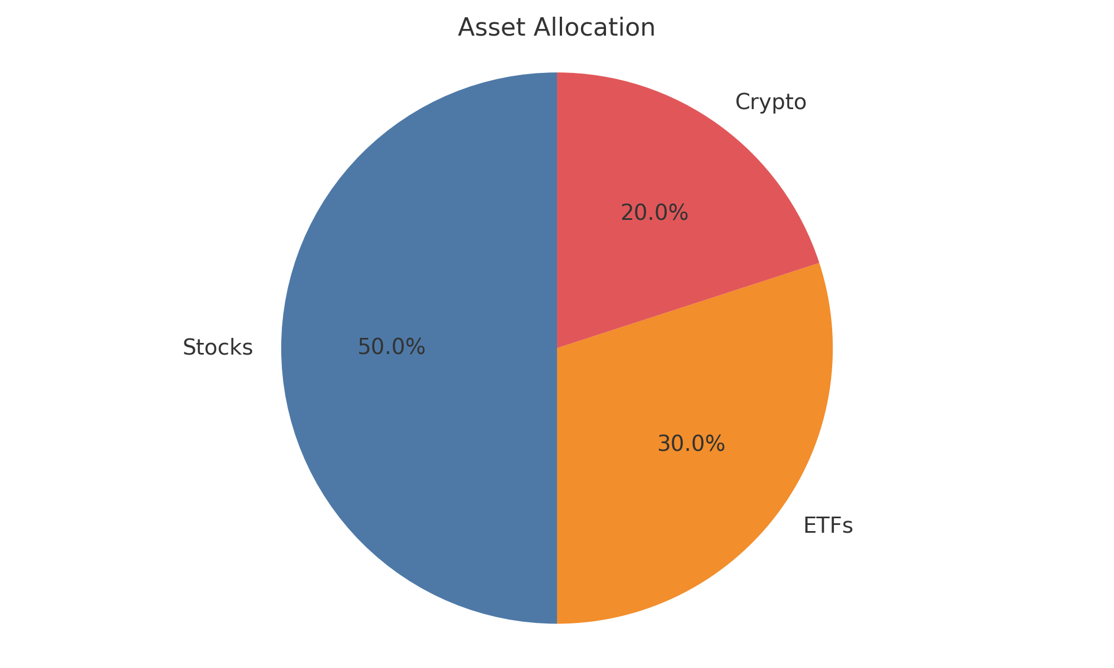
Portfolio Management
Strategic mix of assets aligned with goals and risk tolerance
Involves asset selection, allocation, and periodic rebalancing
Aims to maximize returns while managing risk

Slide 5
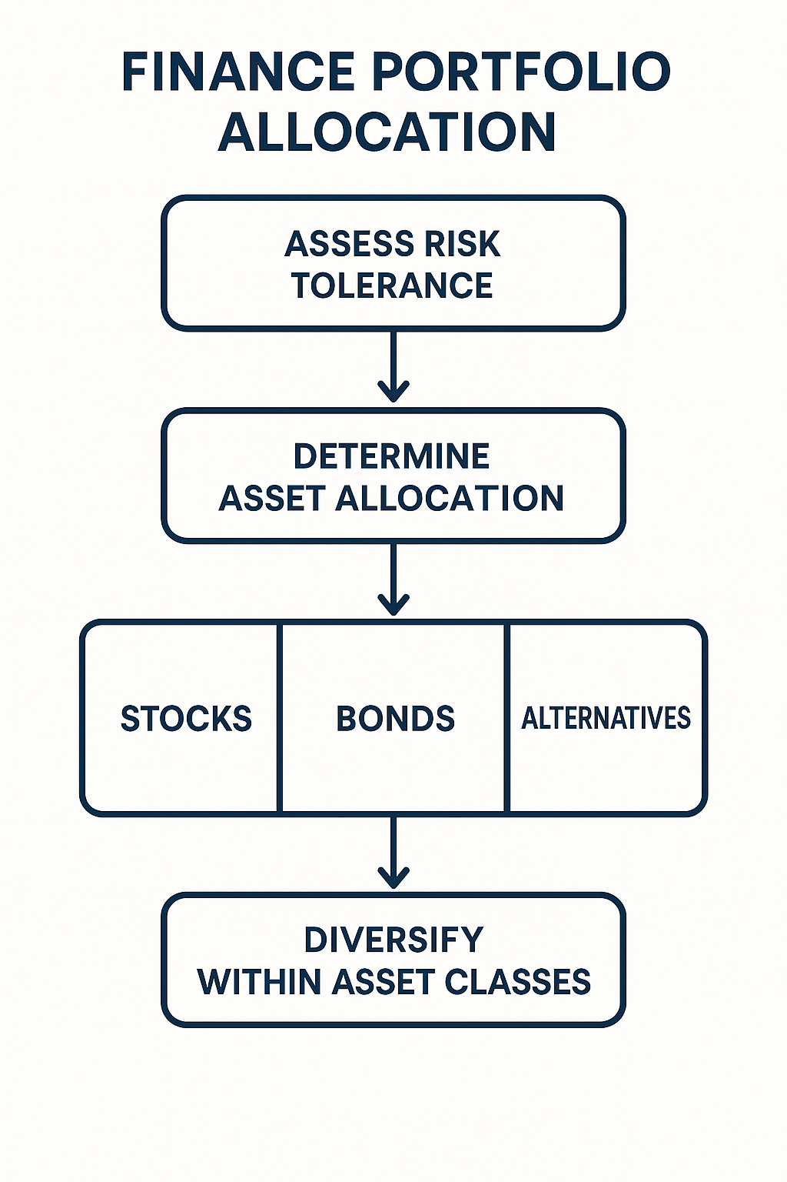
Steps For Portfolio Allocation

Slide 6
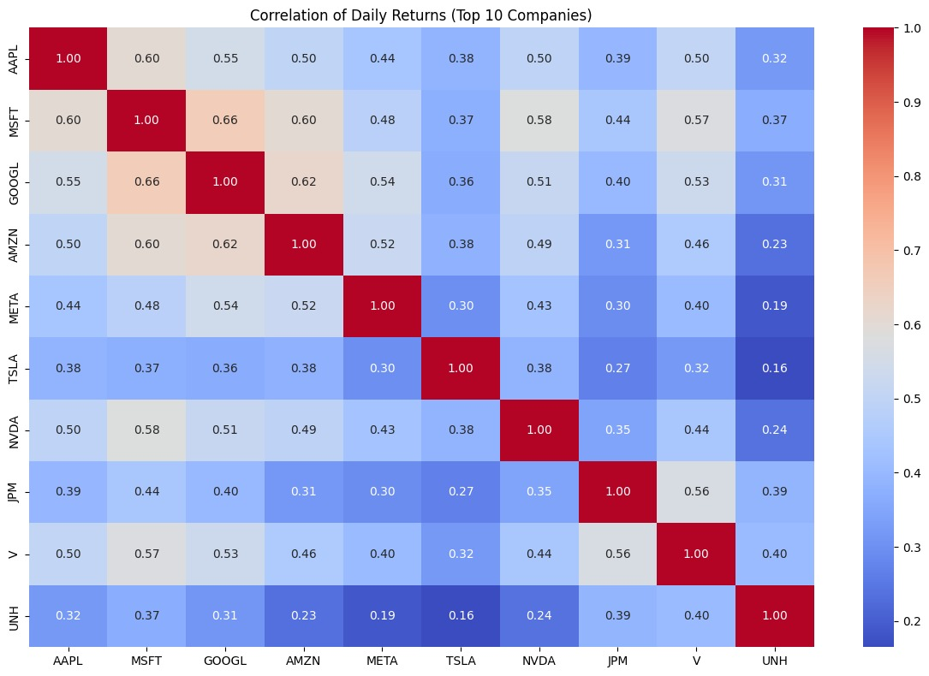
Diversification Benefit

Slide 7
Let’s talk numbers!!!
30-40%
~10%
~5–6 %
5%
Historical returns
Stocks
Diversification
Reduces volatility
Crypto
Crypto boosts diversification

Slide 8
Problems
Markets are volatile and fast-changing ⚡📉
Traditional methods are rigid and slow to adapt ⚙️🐢
Fail during high uncertainty or regime shifts ⚠️🌪️
Economic and sentiment data often ignored 📰💬
Lack real-time, adaptive decision-making ⏱️📊

Slide 9
Why would someone wants to solve this problem?
Improved ROI and better risk control through smarter allocation
Competitive edge with AI-driven, data-based decision systems
Unified management of stocks, ETFs, and crypto for diversification
Increased operational efficiency via automated portfolio decisions
Opportunity to leverage real-time economic and sentiment data

Slide 10
Differentiation
Our agent-based models incorporate a wide range of factors—like
historical prices
financial indicators
Market Regimes
and market sentiment from news or social media—to simulate investor behavior.
These models are tested using paper trading, which lets them make virtual trades without real money to evaluate performance in real-time market conditions.

Slide 11
Target Audience
Everyday Investors
Young Professionals and Millennials
Fintech Startups & Companies

Slide 12
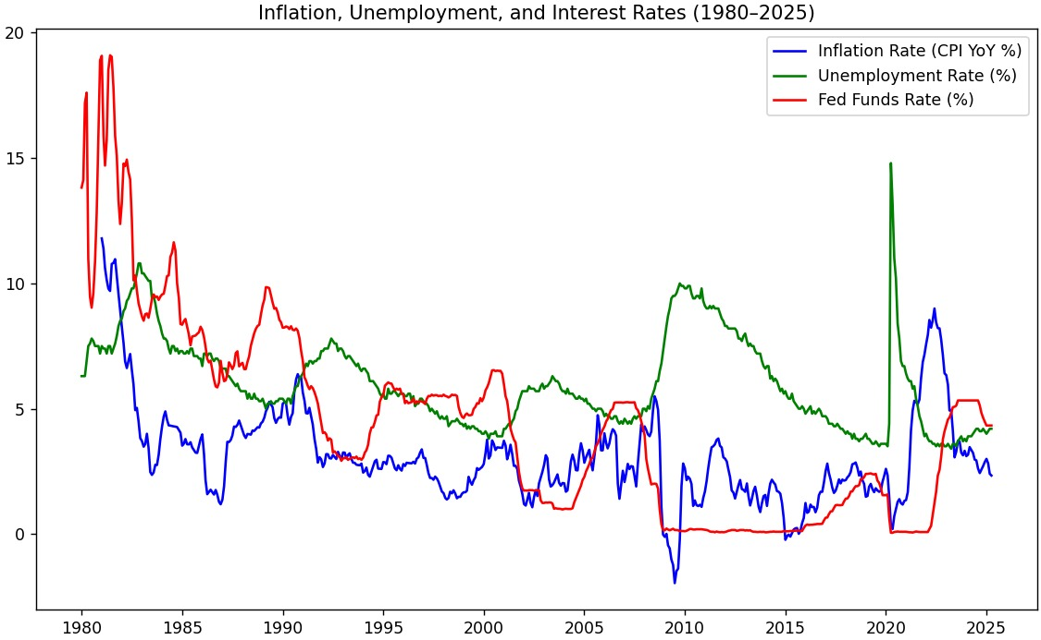
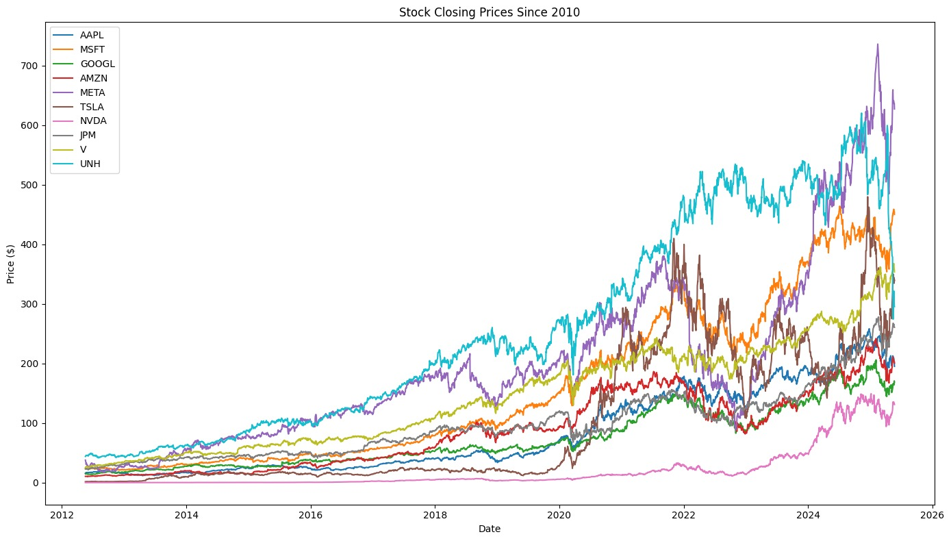
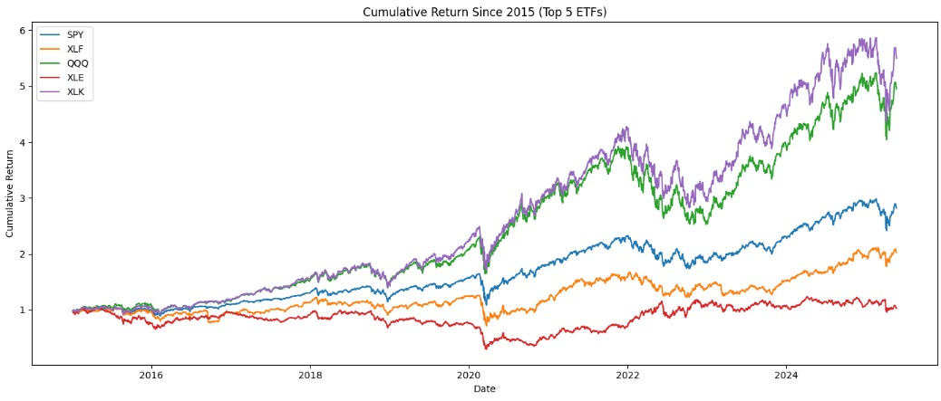
Data and Insights
Total - 10k + rows of combined data

Slide 13
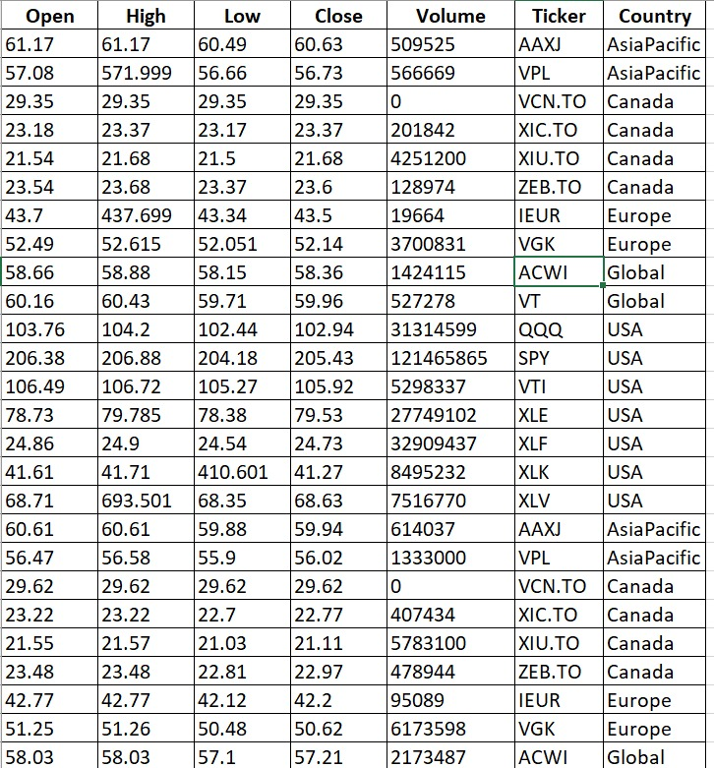
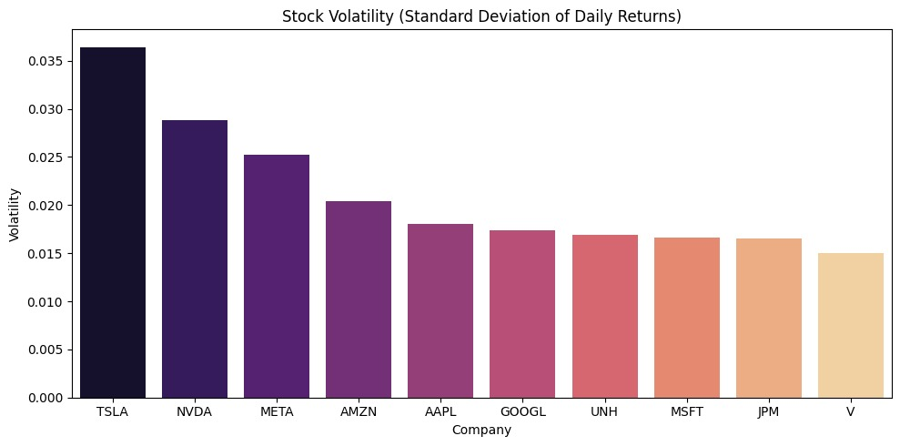
Data and Insights

Slide 14
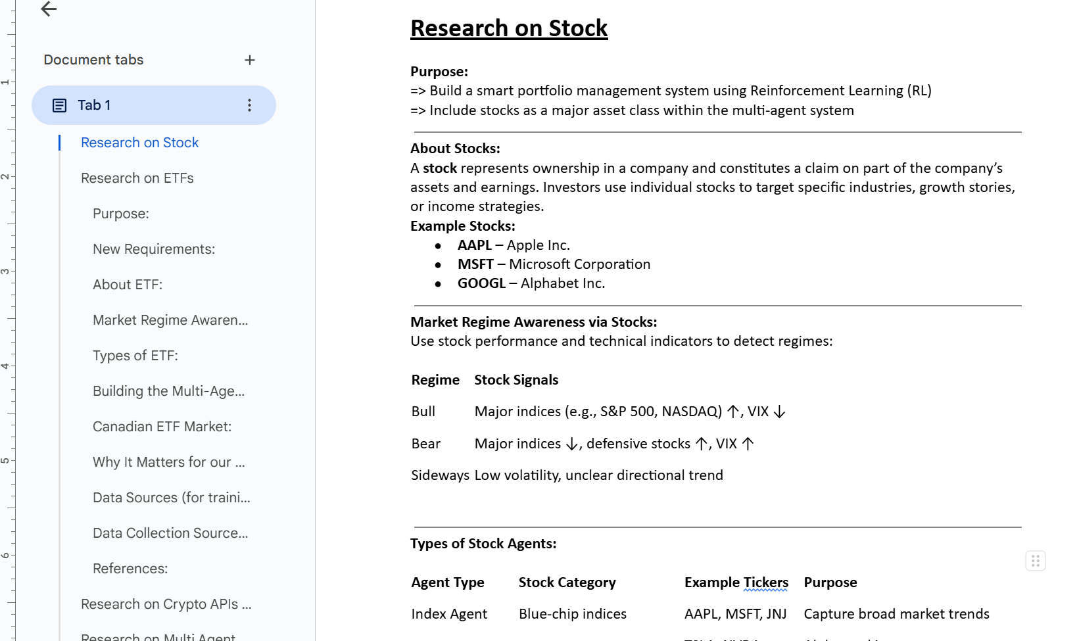
MASTER DOC
Link to Master Doc

Slide 15
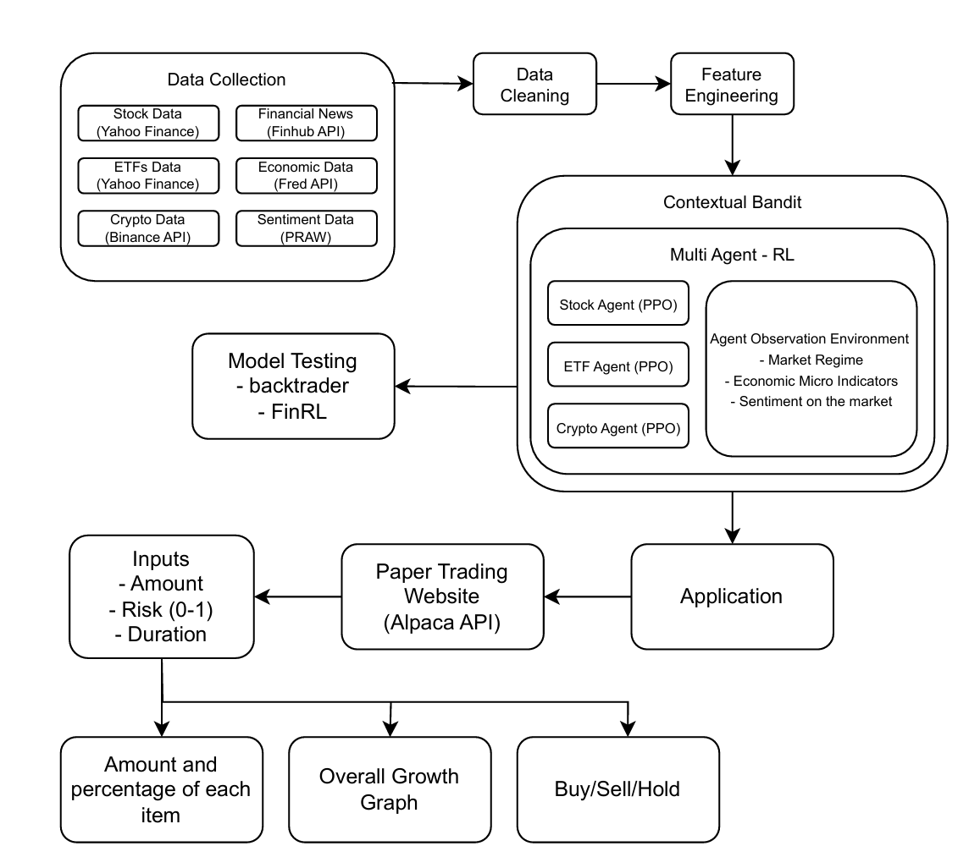
Big Data Pipeline

Slide 16
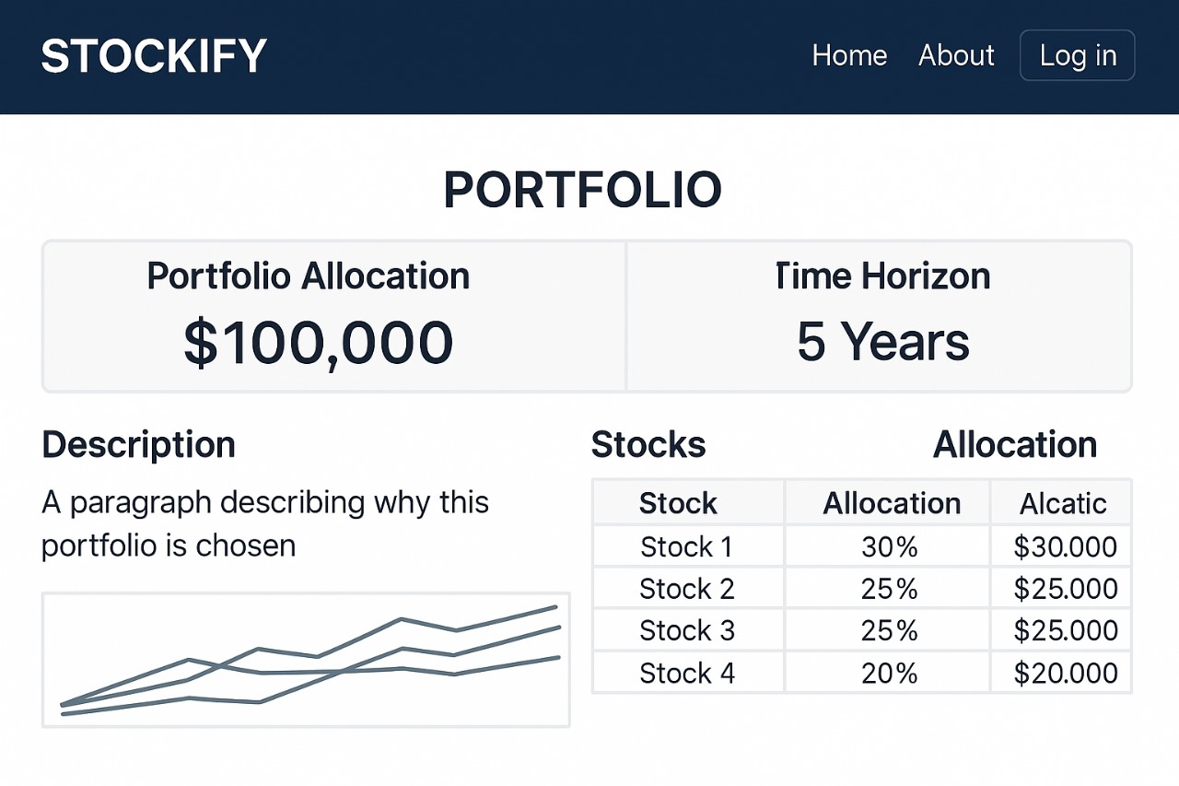
UI Wireframe

Slide 17
Thank you ☺
🚀 AI isn't the future—it's the now of smart investing.

